Slide 1
An Electric Craving
UCSD Data Science and Programming Bootcamp
Project One
Jacob Zacarias
Sanabu Washizuka
Tanlin Hung
Walaa Alani

Slide 2

Introduction
"Todd"
Lives in San Diego, CA
Enjoys rock climbing
A foodie
Looking to buy a new car

Slide 3
Theme of the Study
“Should I get an electric vehicle over a gas-powered car?”

Slide 4
EV or Gas Car?
Q1. Will I be able to find charging stations wherever I am?
Q2. Out of both categories (EVs and gas-powered cars) which make and model is the most cost-effective for their fuel?
Q3. Will EVs really pay themselves off?
Q4. What factors might hint that a city has a lot of charging stations?
Q5. How much will I save on a trip?

Slide 5
Brief Summary of findings
Q1. Will I be able to find charging stations wherever I go?
Simple search on the web,
Google map
Applications: PlugShare, Open Charge Map
And off course you can charge at home ☺
Any of the above and more will give you the locations where you can find outlets to charge your car

Slide 6
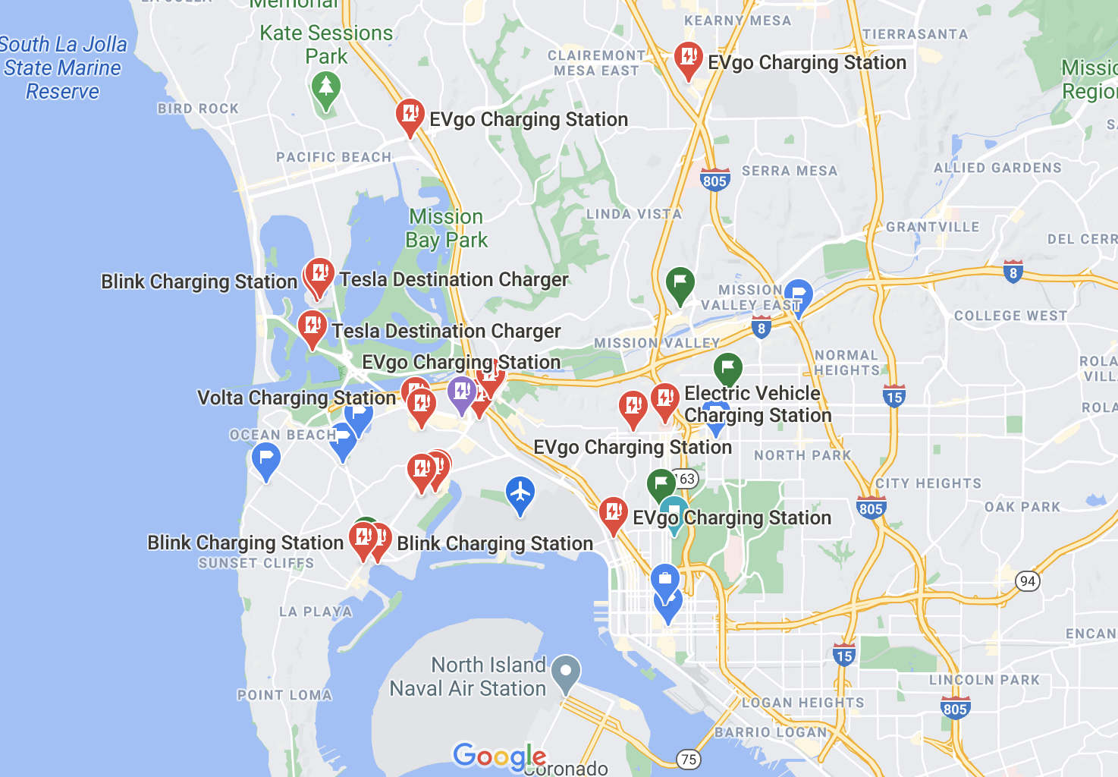
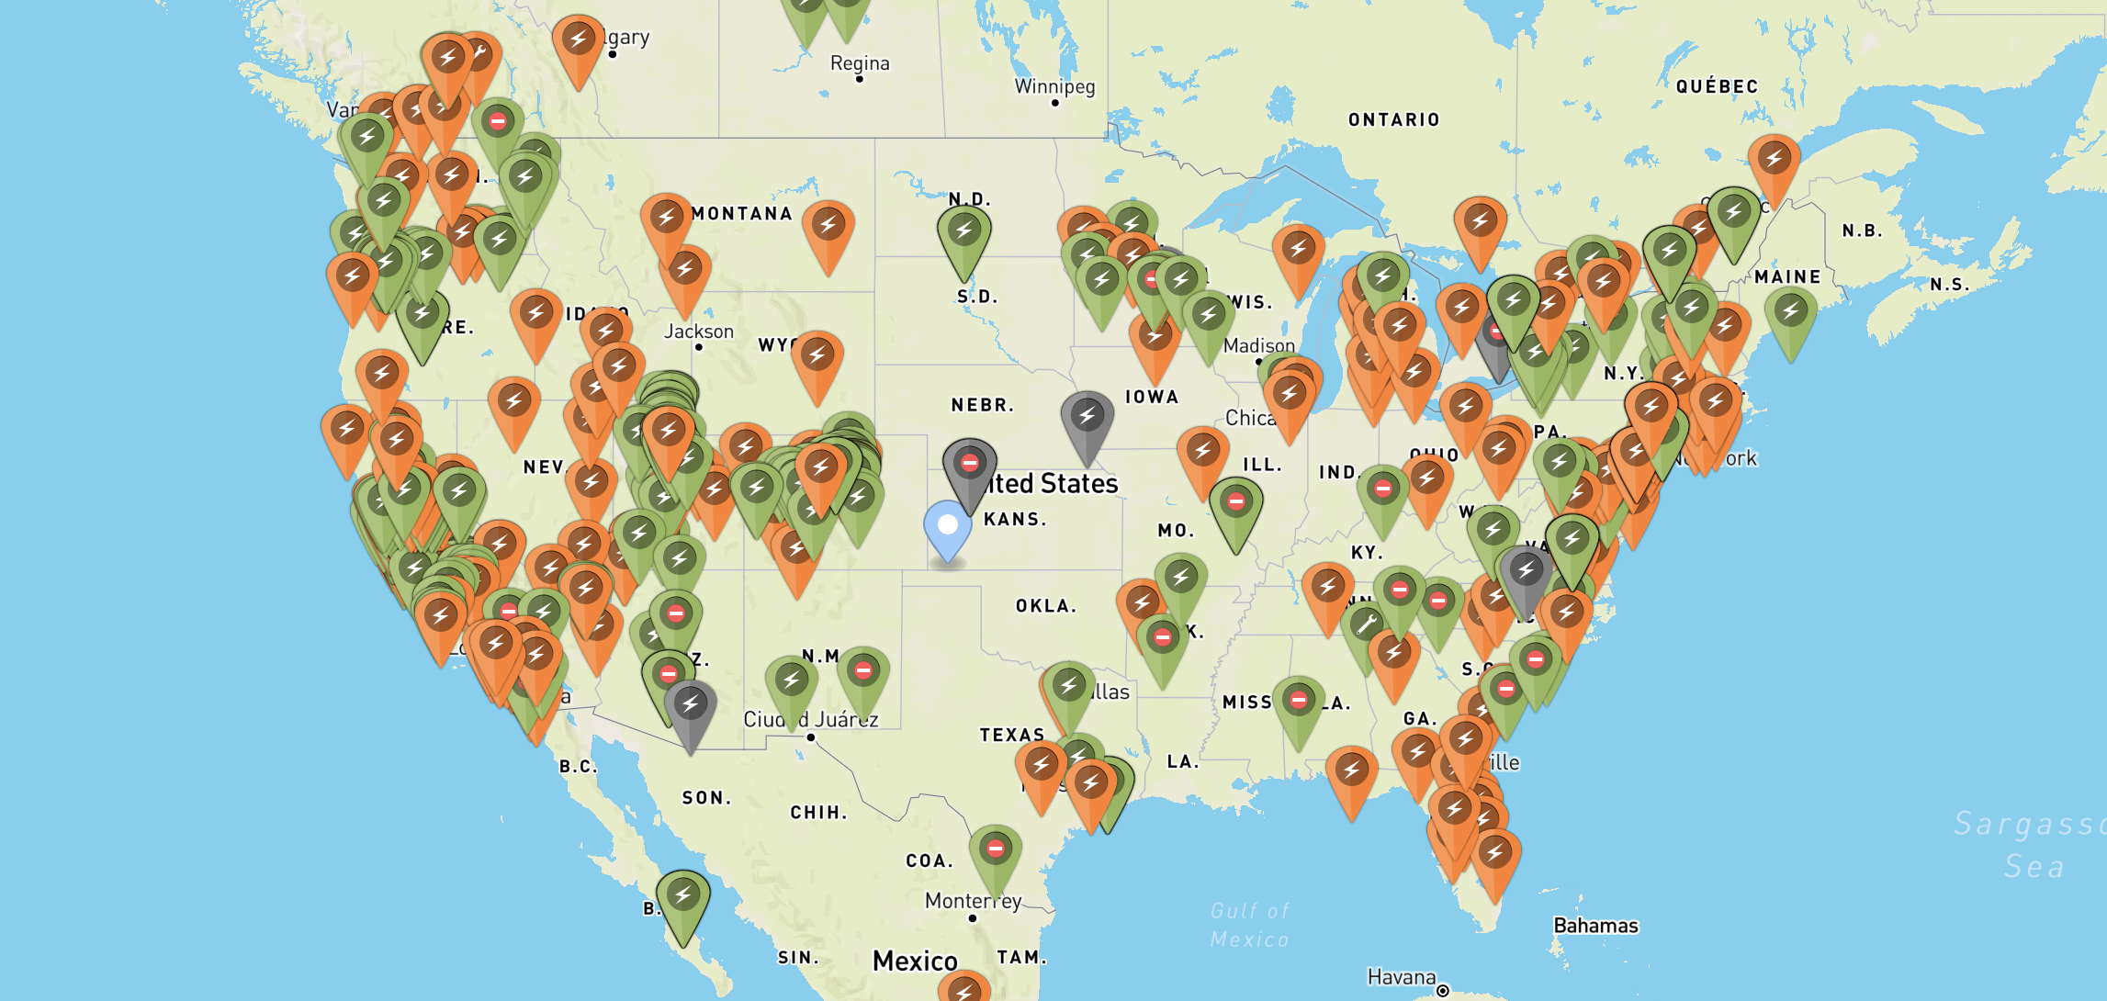
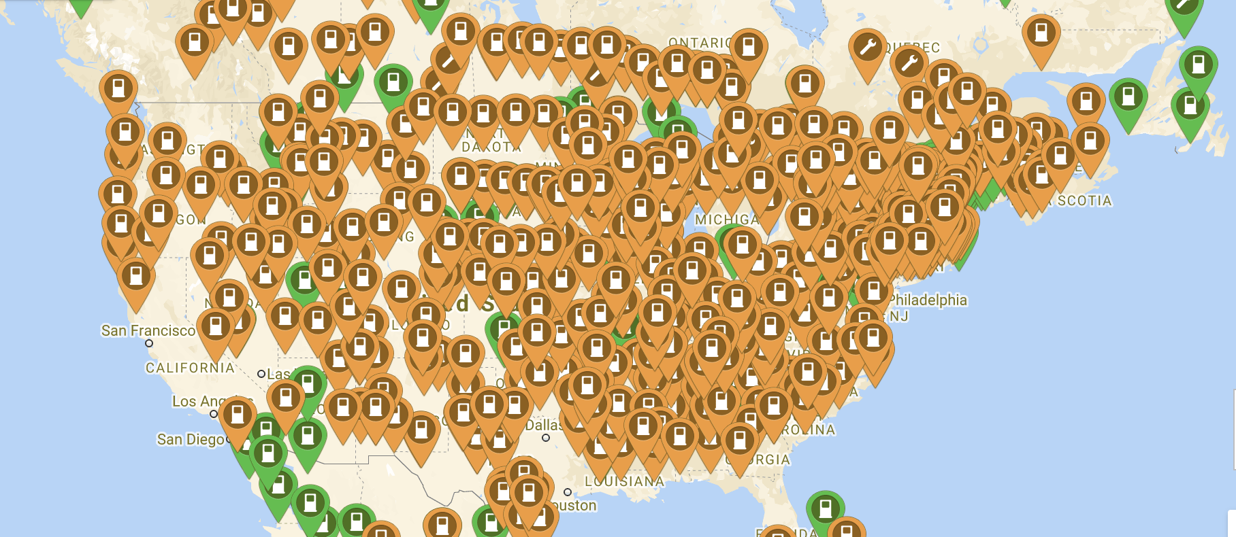
Google Map
Open Charge Map
PlugShare

Slide 7
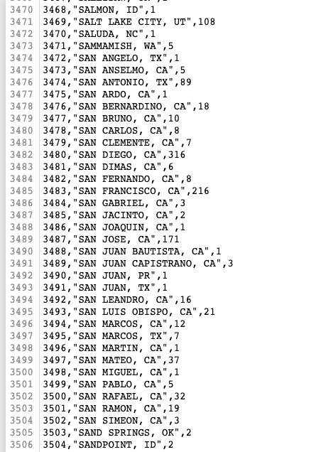
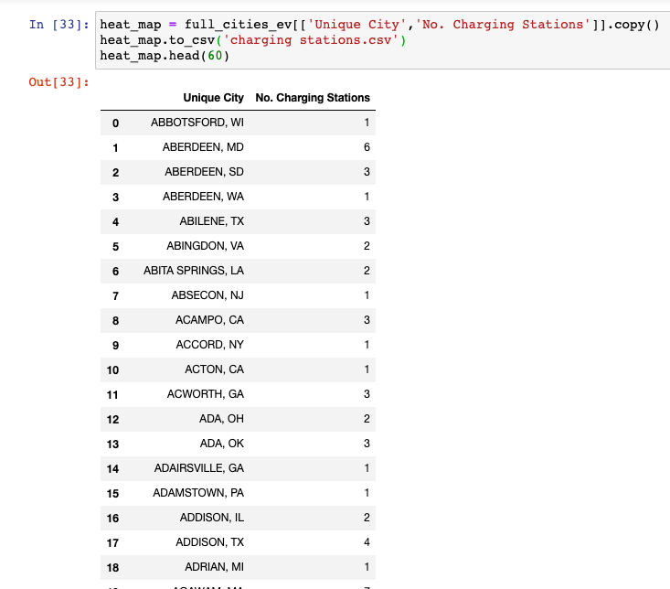

Slide 8
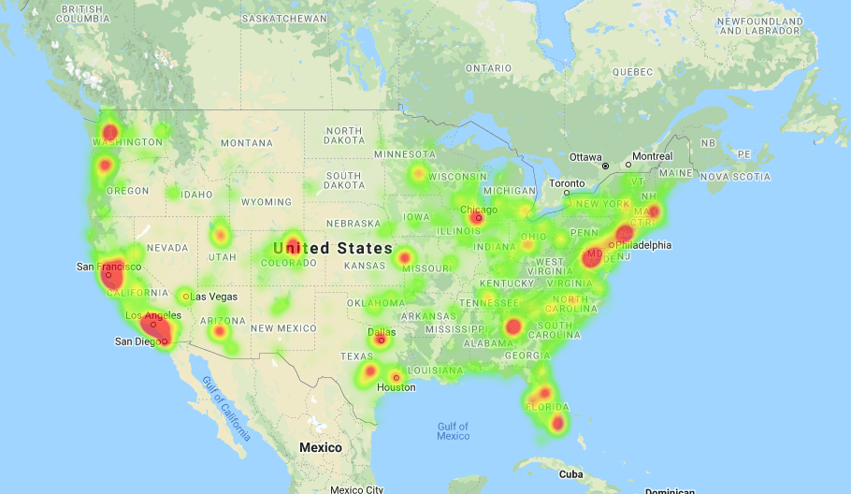

Slide 9
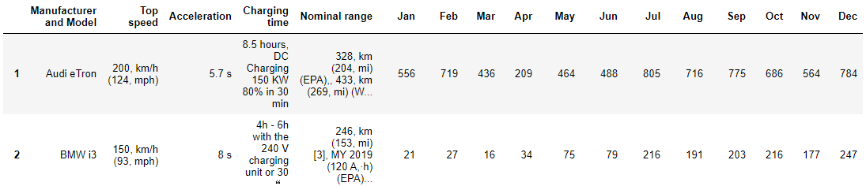
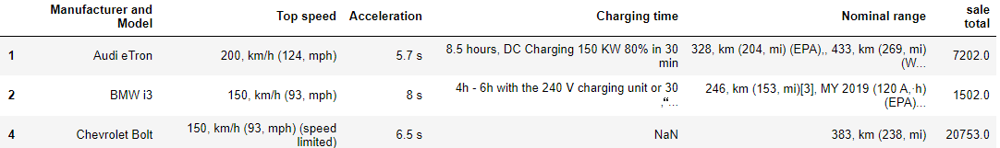
->
->

Slide 10
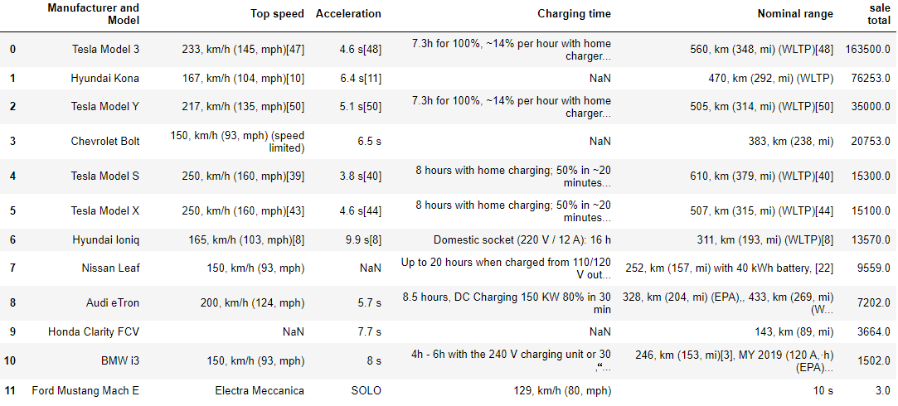
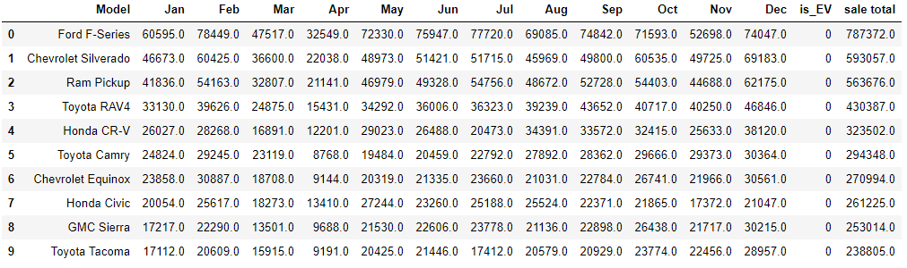
Top 10 Sale
- EV Car
Top 10Sale
-Gasoline Car

Slide 11
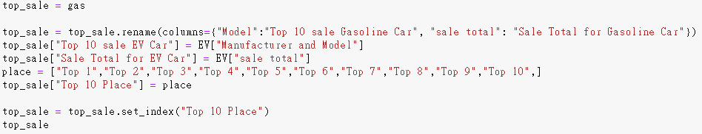
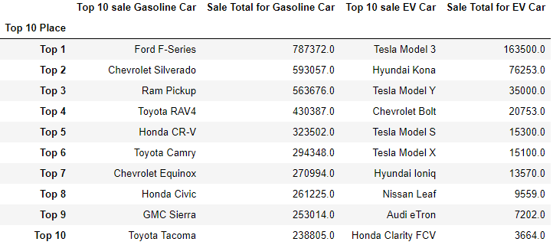
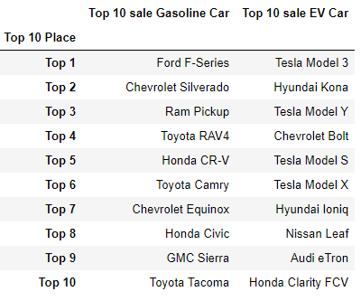

Slide 12
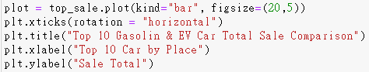
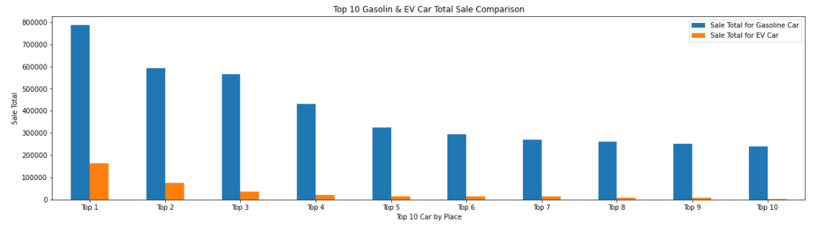

Slide 13
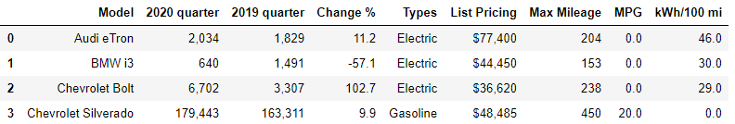
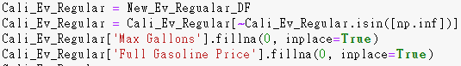
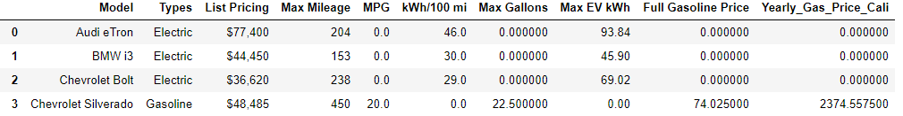
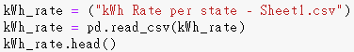

Slide 14
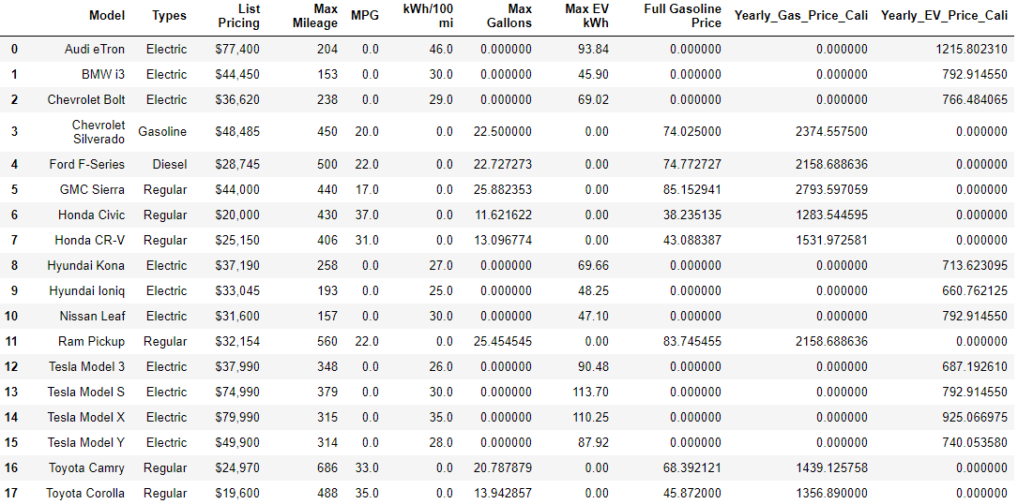

Slide 15
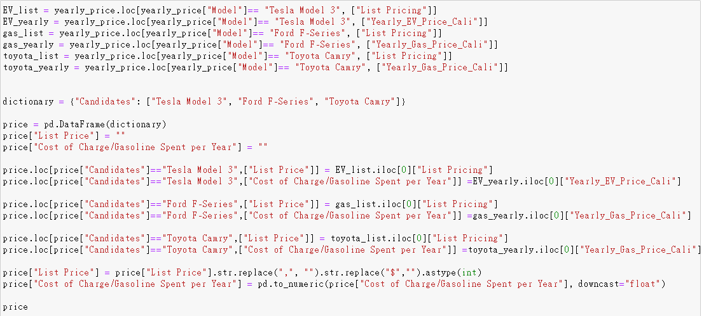
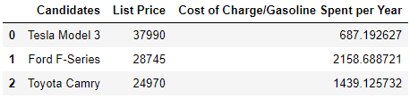

Slide 16
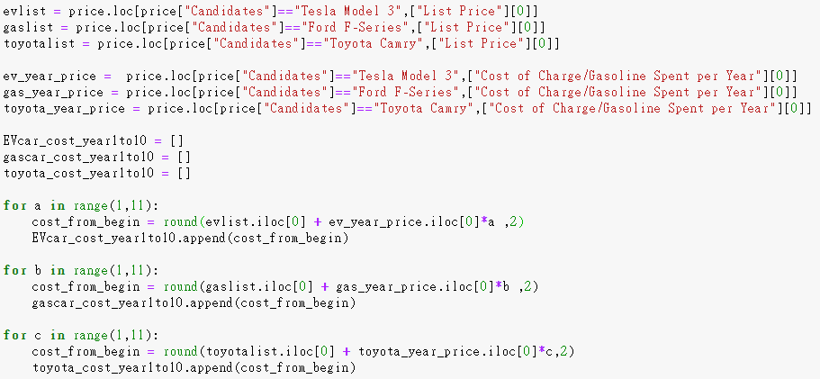
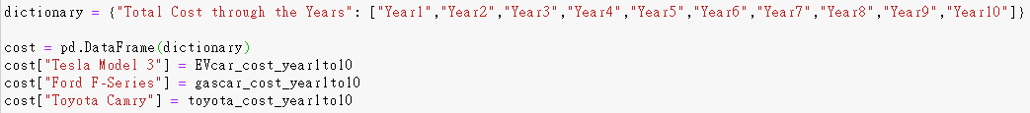
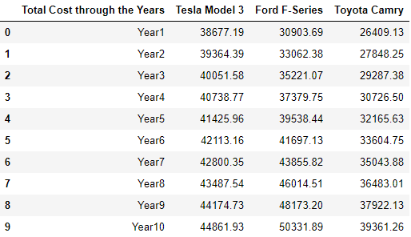

Slide 17
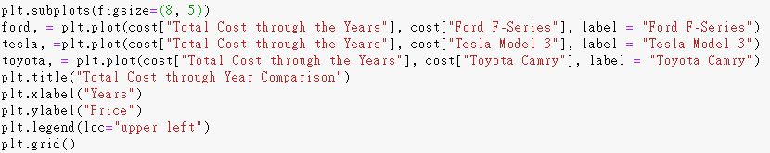
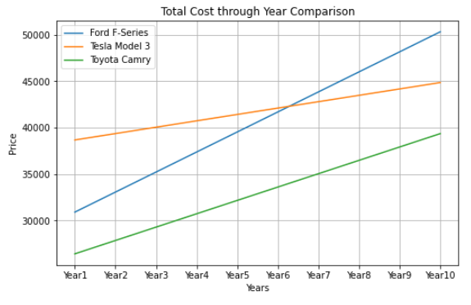

Slide 18
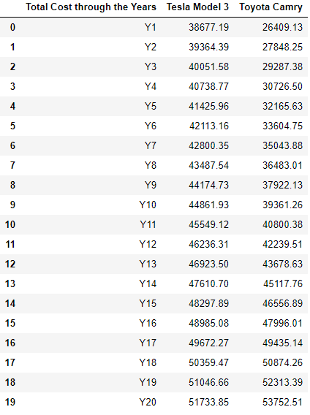
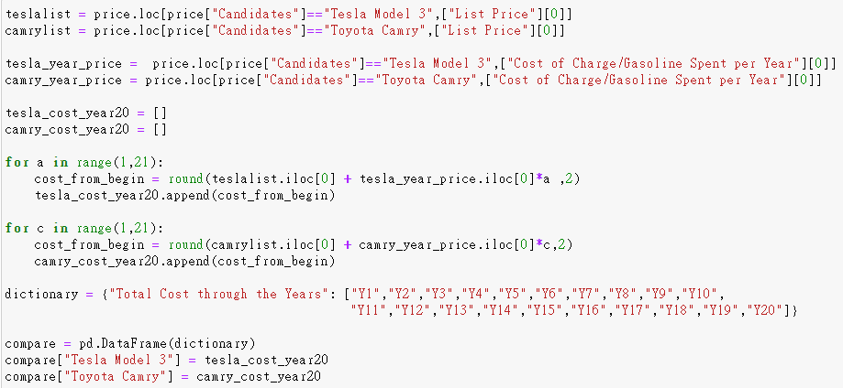

Slide 19
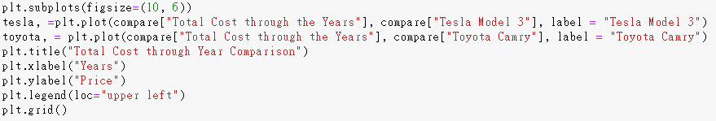
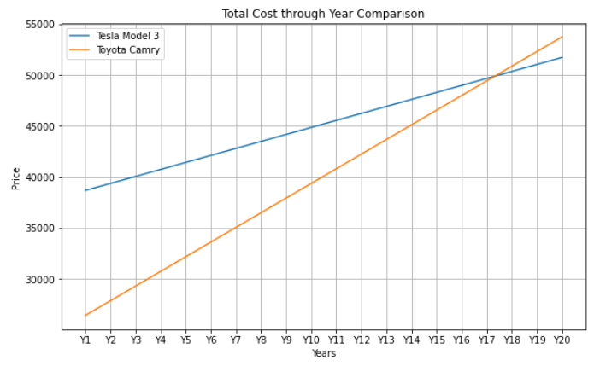

Slide 20
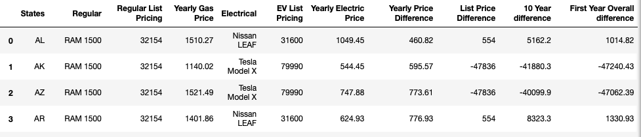
Q3 Pt 1 The Two types of Graphs
Top selling EV and Car in the US compared in each state
Top selling EV and Gas in each state comparison

Slide 21
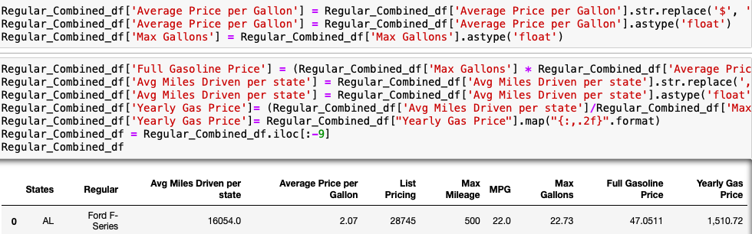
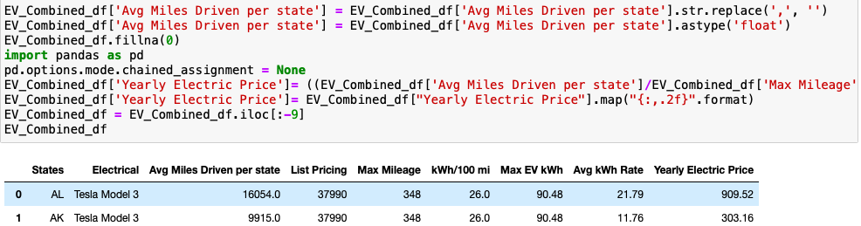
Q3 pt 2 Coding process
Coding Process to receive the Yearly gas and EV price for each state
Tesla 3 vs Ford F series

Slide 22
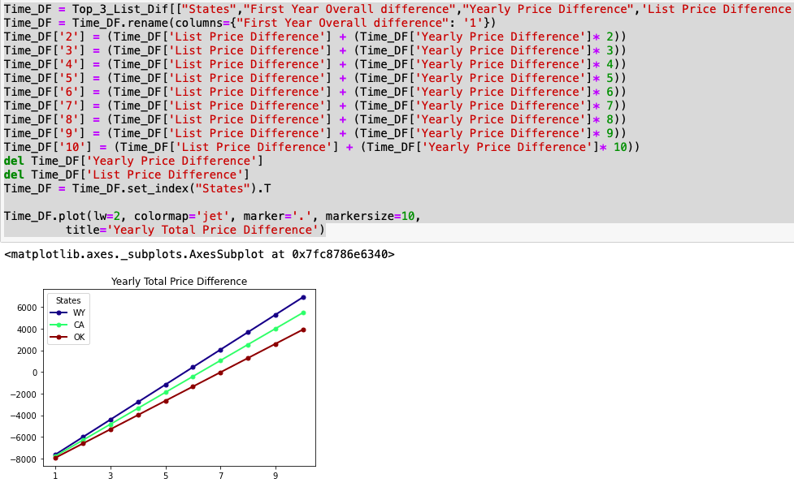
Q3 pt 3 Coding
Coding for 10 year graph of total yearly price difference.

Slide 23
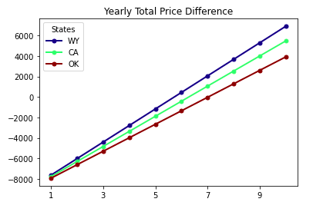
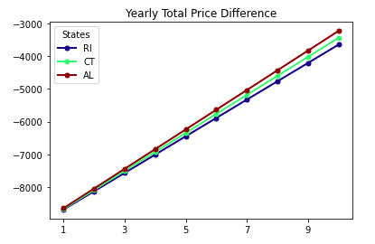
Q3 pt 4Tesla 3 vs Ford F Series
Years it takes for Tesla to payout the Price Difference
Top 3 States
Bottom 3 States

Slide 24
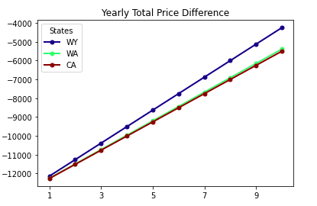
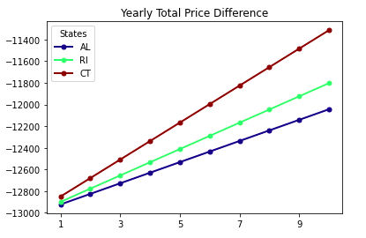
Q3 pt 5 Tesla 3 vs Toyota Camry
Years it takes for Tesla to payout the Price Difference
Top 3 States
Bottom 3 States

Slide 25
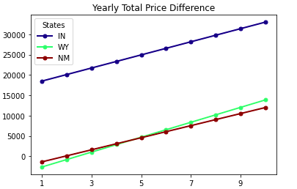
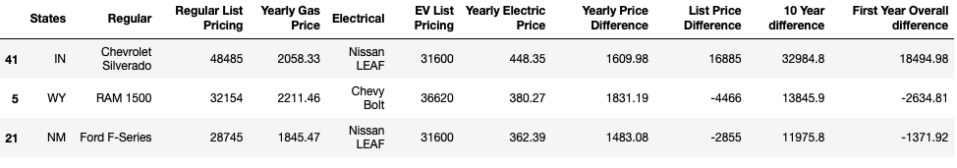
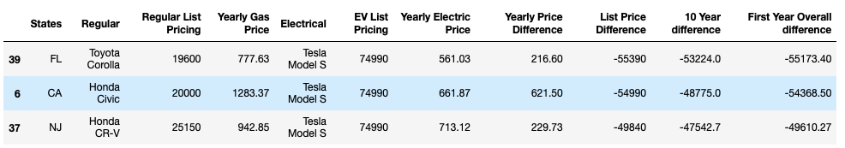
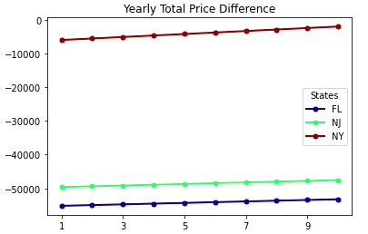
Q3 pt 6 Top Cars in each State EV vs Gasoline
Years it takes for top EV to payout in each state Price Difference

Slide 26
Q3 Will EVs really pay themselves off?
With the code we ran we were able to find if the Tesla 3 with a selling Price of $37,990 will be able to pay off
The difference in prices between the Ford F-Series and the Toyota Camry.
For the top three states like Wyoming, California and Oklahoma the EV owner will actually make a net positive
over 3k from the differential pricing.
For the bottom three states that is Rhode Island, Connecticut , and Alabama the Ev owners would be
a few thousand dollars behind the breaking point to even out the price differences.
When it comes down to the Toyota Camry, EV owners would be 4 to 6 thousand dollars away from reaching
the breaking point.
The price difference between the Tesla 3 and the Toyota Camry in the top three states were 4 k to 6k away
from reaching the breakpoint in a ten year span.
For the the worst three states you would barely make 2k back.
The reasons for this big disparity is do to the affordable fuel efficient costs of the Toyota Camry that minimize
the cheap fuel alternative the EV’s provide

Slide 27
Q.4 What factors might hint that a city has plentiful charging stations?
In other words: "If I were to move or travel elsewhere, what other factors about a city could I look at to see how reliably I can find a charge station?“

Slide 28
Q.4 Correlational Study
Correlational Study of the "No. of Charge Stations" against other factors within a city
Review "No. of Charge Stations" against :
City Population Density (metropolitan areas = more charge stations?)
Gas Prices (CA only study) (cheaper gas = more charge stations?)
Institution type 1 (to be named later) (more “institution type 1” = more charge stations?)
Notes:
-will be going very quickly through data frame cleaning/sorting
-slow down after the merges

Slide 29
Q.4.1 - City List and City Population Density (cleaning)
Source:
https://simplemaps.com/data/us-cities
General Info:
Information on cities in the U.S.
Used to retrieve current data on population density per city
Notes:
-population density per city

Slide 30
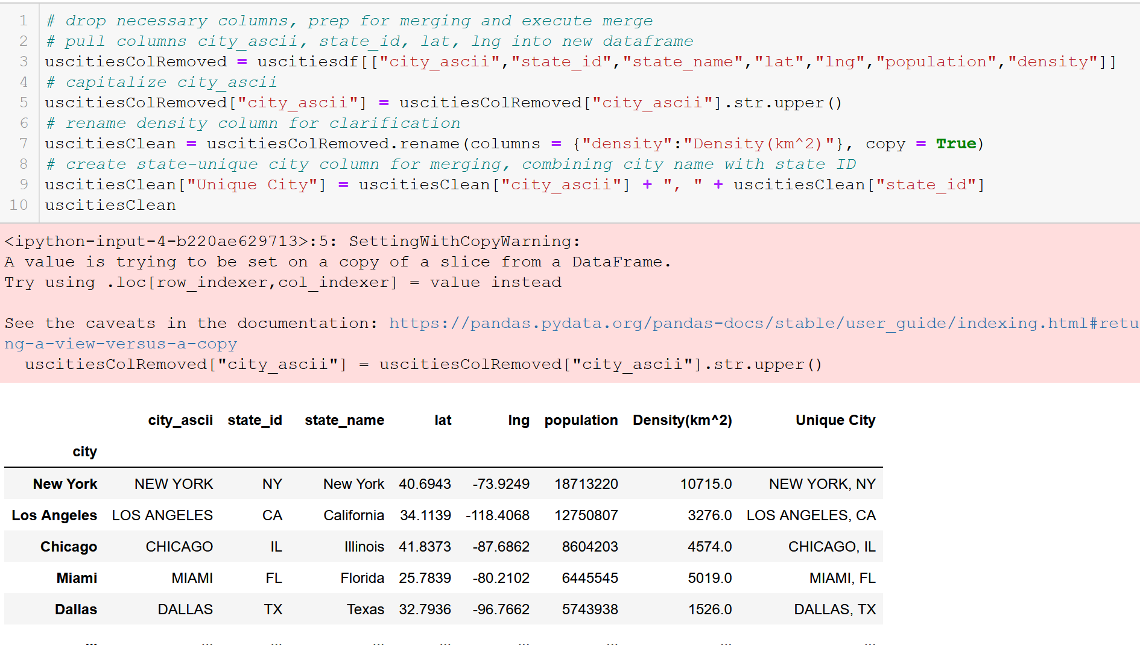
Q.4.1 - City List and City Population Density (cleaning)
Preparing for merge by concatenating city names with states to avoid duping errors
Notes:
Preparing for merge by creating unique keys in “Unique City” series

Slide 31
Q.4.1 – Urbanized Areas (cleaning)
Source:
https://en.wikipedia.org/wiki/List_of_United_States_urban_areas
General Info:
A list of urban areas in the United States as defined by the United States Census Bureau
An urbanized area (UA) is an urban area with population over 50,000
Used to limit cities to observe for API call

Slide 32
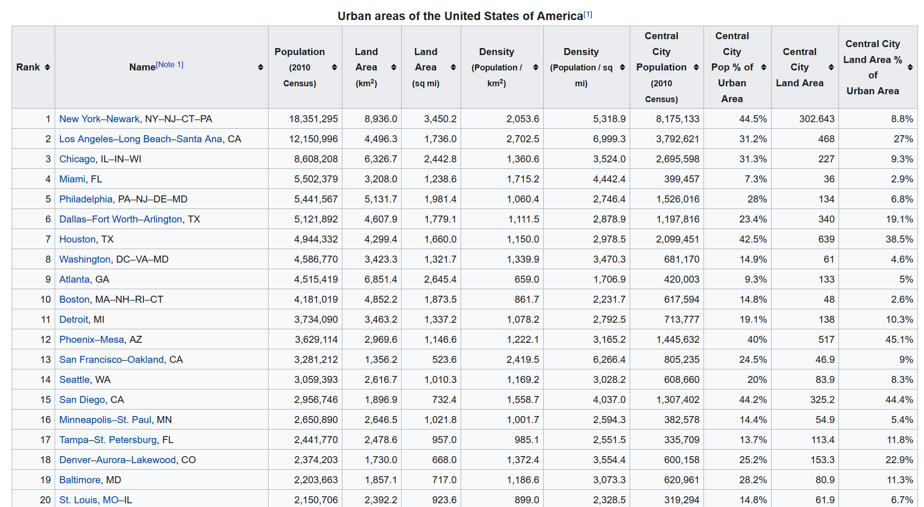
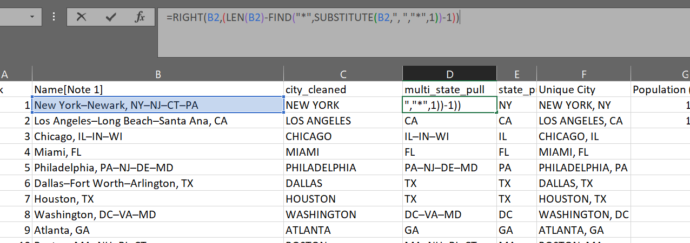
Q.4.1 – Urbanized Areas (cleaning)
Creating state-unique city names within Excel for merging

Slide 33
Q.4.2 – CA Gas Prices (cleaning)
Source:
https://gasprices.aaa.com/state-gas-price-averages/
General Info:
A list of gas prices within California per city

Slide 34
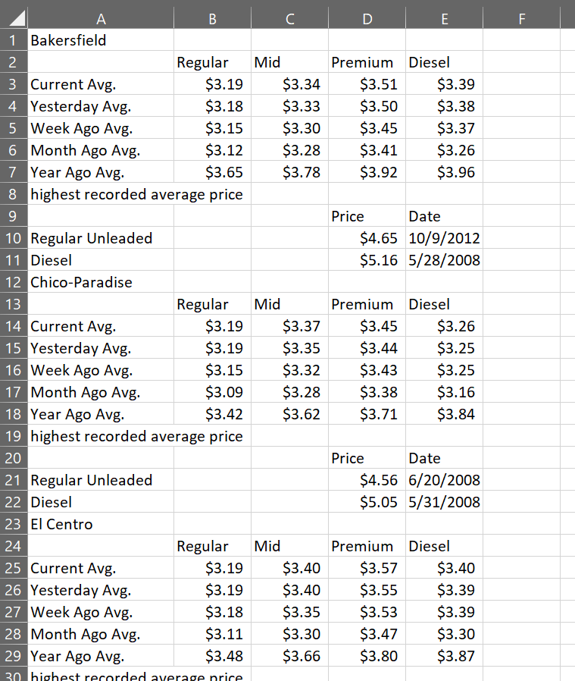
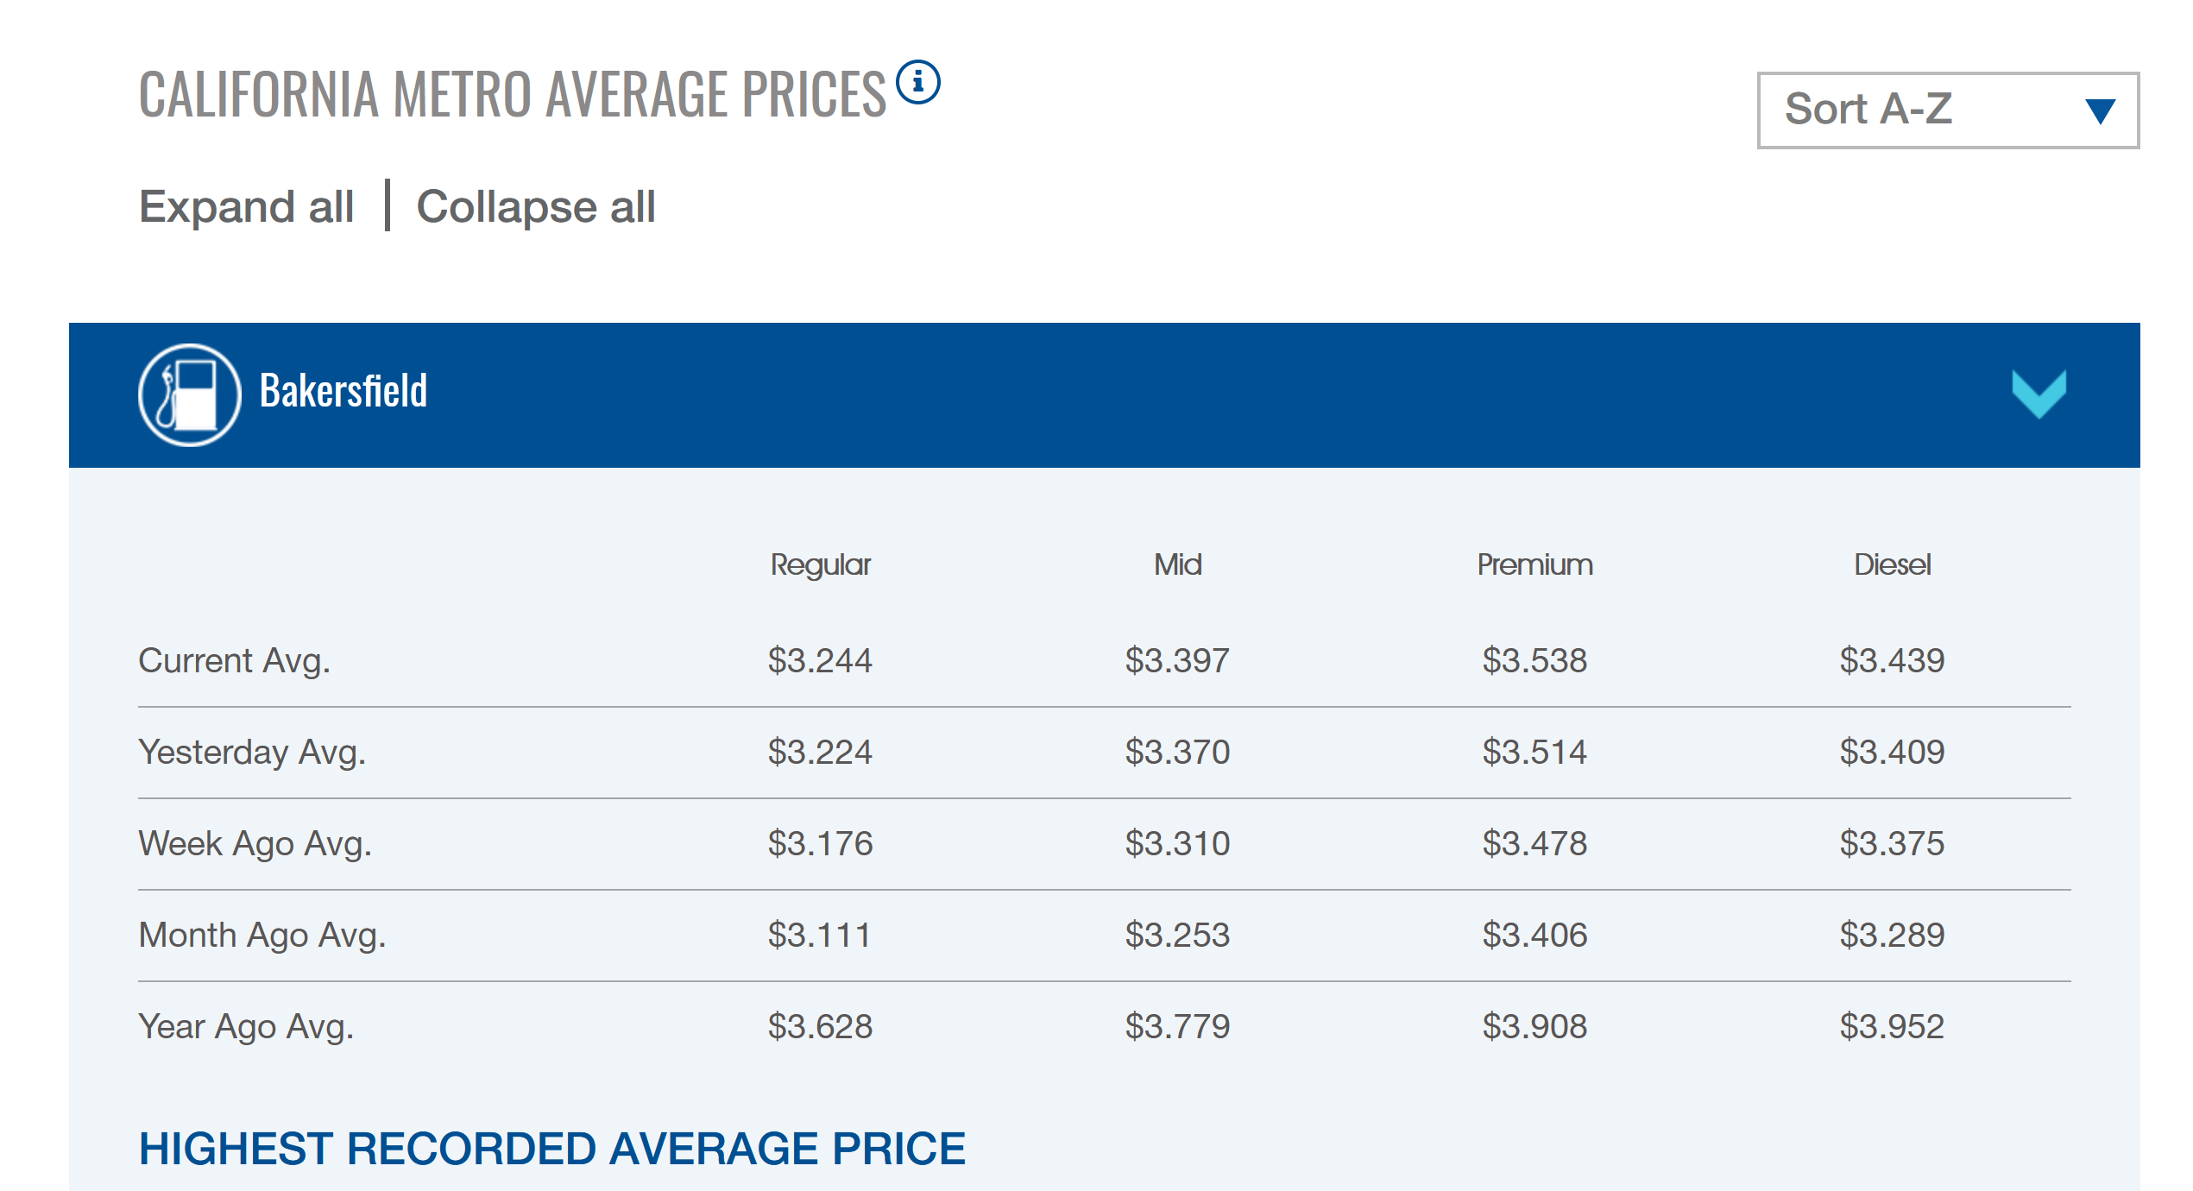
Q.4.2 – CA Gas Prices (cleaning)
Copy/pasted data directly off website onto Excel spreadsheet

Slide 35
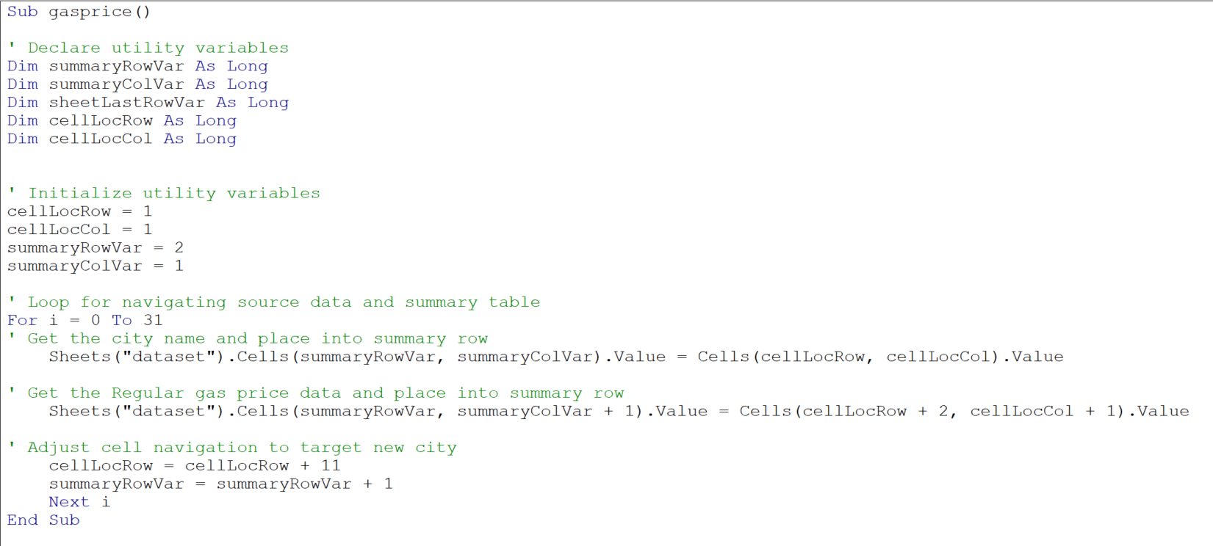
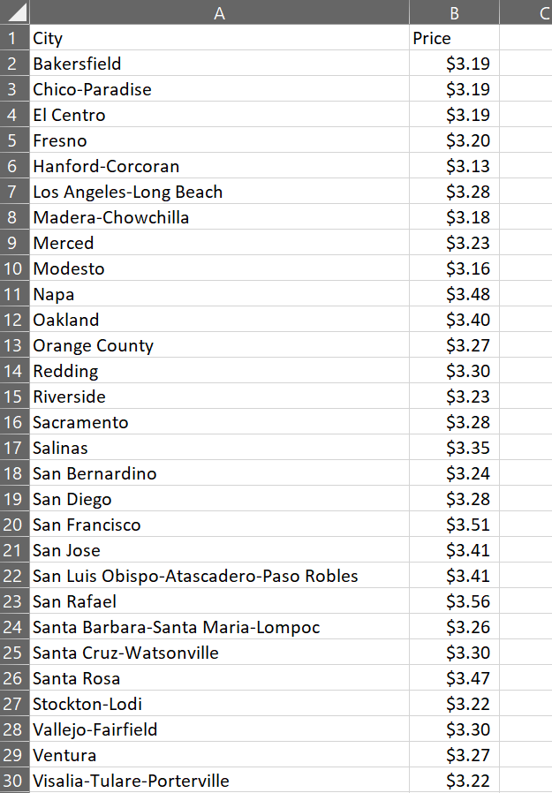
Q.4.2 – CA Gas Prices (cleaning)
Created crawler to pick out necessary data and create a summary table

Slide 36

Q.4.2 – Cities data for Gas Prices (merging)
Creating CA-only list of cities and average gas prices (Regular octane gasoline) with number of EV charge stations for each city
Capitalize city name and add state abbreviation, and inner join on the unique cities
Fixing “Price” data’s data type to floats
Notes:
-merge cities to gas prices AND charge stations

Slide 37
Q.4.3
Data cleaning/merging is finished for the first two studies
But what happened to the other study on the “institution”???
(We’ll get back to that)

Slide 38

Q.4.1 – Creating scatterplot with R^2

Slide 39

Q.4.1 – Scatterplot for Q.1

Slide 40

Q.4.1 – CA Cities data for population and “institutions” studies
Weak R-squared – likely no correlation between no. of charge stations and population density

Slide 41

Q.4.2 – CA Cities data for gas prices
Very weak R-squared – likely no correlation between no. of charge stations and gas station prices
Much lower R-squared than population density

Slide 42
Q.4.3 What else is there? (institution type 1)
Reflection of established infrastructure
Symbol of a “developed” society

Slide 43

Q.4.4 What else is there?

Slide 44


Q.4.3/4 – Yelp API
Use Yelp API to search for number of McDonald’s in each city
Loop through the cities data frame and make calls to the API for each city
Count the number of times the search term is found
Stop the city’s query when a response that isn’t the search term is found

Slide 45

Q.4.3/4 – Yelp API
Notes:
-making a list of “hits” found in each response
-able to compensate for multiple pages by making and checking for a “search complete” state

Slide 46

Q.4.3/4 – Yelp API
Notes:
-setting up request
-making request, and continues on error

Slide 47

Q.4.3/4 – Yelp API
Add each search term hit to valueCount
Add each search term hit on current page response to pageHitCount (to check if the a new page will need to be searched for)
On the first “name” key where the value is not the search term, add the count value to the list for this city, indicate that the query for this city has ended (searchCompleteVar)
Notes:
-count number of hits
-keeping track of hits per page to know when to move pages
-code will stop when…

Slide 48

Q.4.3/4 – Yelp API
API allows a limit of 50 results per response
Check to see if the city’s query is not complete. If not, move to next page by adding the page’s hits to the result offset parameter for the API, and loop back to making a new query (same city, different page)
When this city’s query is complete (including additional pages) add search term hit count to the valueList and move to next city in cities data frame
Notes:
-API allows for only 50 results

Slide 49

Q.4.3/4 – API Query Progress Tracking

Slide 50

Q.4.3 – No. of McDonald’s
Moderate R-squared – possible correlation between no. of charge stations and McDonald’s (though not likely)

Slide 51


Q.4.4 A Thought
“Are McDonald’s and Tesla conspiring together on a secret partnership?!?!”
*Todd does not understand the concept of “correlation does not equal causation”

Slide 52
Q.4 Summary
Few properties of a city (if any) reflect charge station availability
Los Angeles, CA potentially skews the study with a large amount of charge stations (reflect on what constitutes an “outlier” for correlational studies)

Slide 53


The “Electric” Craving

Slide 54



The “Electric” Craving
Todd needs a genuine northeastern lobster roll RIGHT NOW
Great place on Yelp in Portland, Maine!

Slide 55


The “Electric” Craving
Just finished eating a California burrito in in San Diego, California

Slide 56
The “Electric” Craving
How many cross-country trips would it take in fuel savings to pay off the purchase price difference between the Tesla and the Ford F Series?

Slide 57


The “Electric” Craving
Gas-powered Vehicle
Electric Vehicle
Stop Location | Cost to Refuel
Pahrump, Vegas | $10.00
Price, Utah | *$0.00
Glenwood-Springs, Colorado | $32.25
Scottsbluff, Nebraska | **$0.50
Lincoln, Nebraska | **$0.25
Iowa City, Iowa | **$0.70
Elkhart-Goshen, Indiana | $5.00
Cleveland-Elyvia, Ohio | **$1.00
Binghamton, New York | $9.00
Worcester, Massachusetts | $11.25
Total | $69.95
Electric Route Map
Stop Location | Cost to Refuel
Central Valley, Utah | $44.40
Big Spring, Nebraska | $44.80
Grinnell, Iowa | $44.60
Cleveland, Ohio | $45.20
Worcester, Massachusetts | $45.20
Total | $224.20

Slide 58
The “Electric” Craving
Car Model | Gas/ Battery Capacity | Miles / Filling | Stops / Trip | Fuel/ Charge fees per Trip | Ave. Car Price
Ford F Series | 23 gal | 690 | 5 / 7 | $224.20 | $51,585.00
Tesla 3 | 75 kWh | 348 | 10 | $69.95 | $48,190.00
How much more expensive the Tesla M3 price is: | $3,395.00
How much cheaper the EV charge costs are for entire trip: | $154.25
How much of the difference in MSRP is paid for by the savings in fuel: | 4.54%
Number of one-way cross-country trips necessary for the Tesla Model 3 to pay itself off in fuel savings: | 22 Trips

Slide 59


The “Electric” Craving
Which means: how many more San Diego California burritos and Portland, Maine lobster rolls does Todd need to eat in order for the Tesla Model 3 to pay itself off in fuel costs?
CA Burrito | Lobster Rolls
11 | 10
Todd senses a sudden craving for another California burrito…

Slide 60
Sources
(2019). AAA Gas Prices. https://gasprices.aaa.com/state-gas-price-averages/ | (Jan 2021). List of United States urban areas. Wikipedia. https://en.wikipedia.org/wiki/List_of_United_States_urban_areas
(2010-2021). SimpleMaps.com. https://simplemaps.com/data/us-cities | (2004–2021). Yelp Inc.. https://www.yelp.com/fusion
(2021). Geeme. https://geeme.now.sh/ | (2021). vecteezy. https://www.vecteezy.com/free-vector/sandwich
(2021). Recargo, Inc.. https://www.plugshare.com/

Slide 61
Thank you!

